Slide 1



A CENTER FOR INTER-DISCIPLINARY RESEARCH
2020-21
TITLE
“PERSONALITY PREDICTION USING MACHINE LEARNING”
SUPERVISED BY
PADMINI MADHIRA KOUSALYA AND MOHIT SURYADEVARA
GOKARAJU RANGARAJU
INSTITUTE OF ENGINEERING AND TECHNOLOGY
AUTONOMOUS

Slide 2
Advanced Academic Center
( A Center For Inter-Disciplinary Research )
This is to certify that the project titled
“PROJECT TITLE”
is a bonafide work carried out by the following students in partial fulfilment of the requirements for Advanced Academic Center intern, submitted to the chair, AAC during the academic year 2020-21.
NAME | ROLL NO | BRANCH
HARSH BHATNAGAR | 21241A05T7 | CSE
ANUSHA PULIPAKA | 21241A12B3 | IT
AMRUTHA YARLAGADDA | 21241A0564 | CSE
NAME | ROLL NO. | BRANCH
BALURI RISHIKA REDDY | 19241A1206 | IT
BETHI VISHNU VARDHAN REDDY | 19241A05U5 | CSE
CHEVVURI SWARNA TEJASWI | 19241A04D1 | ECE

Slide 3
NAME | ROLL NO | BRANCH
SANJANA ALLADI | 21241A6604 | CSM
RANJITH | 21241A05M2 | CSE
This work was not submitted or published earlier for any study
Dr/Ms./Mr.
Dr.B.R.K.Reddy
Program Coordinator
Dr.Ramamurthy Suri
Associate Dean,AAC
Project Supervisor

Slide 4
ACKNOWLEDGEMENTS
We express our deep sense of gratitude to our respected Director, Gokaraju Rangaraju Institute of Engineering and Technology, for the valuable guidance and for permitting us to carry out this project.
With immense pleasure, we extend our appreciation to our respected Principal, for permitting us to carry out this project.
We are thankful to the Associate Dean, Advanced Academic Centre, for providing us an appropriate environment required for the project completion.
We are grateful to our project supervisor who spared valuable time to influence us with their novel insights.
We are indebted to all the above mentioned people without whom we would not have concluded the project.

Slide 5
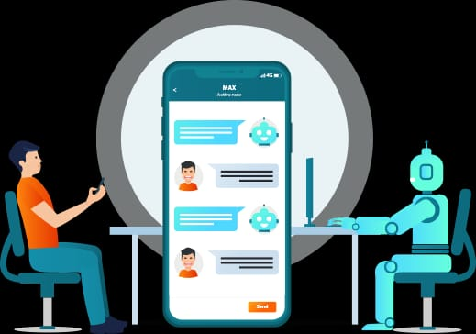

Slide 6
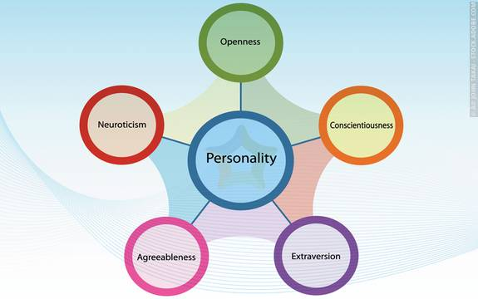
PERSONALITY PREDICTION USING MACHINE LEARNING
ABSTRACT:-
Personality traits are defined as relatively constant patterns of thoughts, feelings, and behavior that have been linked to a variety of significant life outcomes and decisions. Individual relationship satisfaction, job choices, etc., have all been linked to personality traits.
The personality of a human plays a major role in his personal and professional life. Nowadays, many organizations have also started shortlisting the candidates based on their personality as this increase the efficiency of the work because the person is working in what he is good at than what he is forced to do.
INTRODUCTION:-
The OCEAN model of personality views human personality as a combination of 5 personality traits or 5 personality factors: Openness, Conscientiousness, Agreeableness, Extraversion and Neuroticism (making the acronym – OCEAN). Also known as the five factor or big five model, OCEAN model of personality is considered one of the most reliable taxonomy of personality traits, especially in the workplace environment.
The Big Five model is also known as the Five-Factor Model (FFM) and OCEAN model was developed in the early 1980s according to many psychological theories. When the statistical analysis is applied to personality survey data, some words used to describe the person and these words give a summary of the overall character or personality of the person accurately.

Slide 7
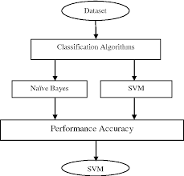
Open to Experience: It involves various dimensions, like imagination, sensitivity, attentiveness, preference to variety, and curiosity. Conscientiousness: This trait is used to describe the carefulness and diligence of the person. It is the quality that describes how organized and efficient a person is. Extraversion: It is the trait that describes how the best candidates can interact with people that is how good are his/her social skills. Agreeableness: It is a quality that analyses the individual behavior based on the generosity, sympathy, cooperativeness and ability to adjust with people. Neuroticism: This trait usually describes a person to have mood swings and has extreme expressive power. With the availability of high-dimensional and fine-grained data about human behaviour it becomes too handy to research and observe human behaviour. Using mobile sensing studies, data collected from our day to day activities have drastically altered how psychologists perform research and undertake personality assessments. Moreover, machine learning algorithms are highly efficient in recognizing patterns in data sets that humans cannot even perceive. Various supervised machine learning algorithms Naive Bayes and Support Vector Machines are widely used in industries to predict personality traits.

Slide 8
This model uses Flask for creating API, JSONIFY for extracting JSON responses and NLP(Natural Language Processing) for extracting NLP makes it possible to quantify and analyse qualitative text data which is in the form of responses. NLP is used to measure and predict psychological traits. For each personality trait, certain questions are asked, and the users have to choose between yes and no. Here we are displaying three out of the Big Five personality traits from which 3 questions will be asked per each trait. Using NLP makes the prediction process convenient but it does not provide an adequate explanation for the predicted results. Flask API is used to interlink the python code from a coding platform such as VS code to the Google Dialogflow servers. JSNOIFY extracts JSON response Ethics in personality prediction The personality report allows to quickly assess if a candidate is suitable for a job position or not, given that it measures workplace personality traits and occupational scores that are predictive of job performance. personality assessments can be used by recruiters as an objective source of reliable information to successfully predict employee performance across a wide range of job categories and to make hiring decisions based on concrete criteria.

Slide 9
Openness: Yes-You are creative, curious and interested in trying out new things. No- You tend to focus more on getting understood rather than understanding people around you. Conscientiousness: Yes- You are a well-organised person and be diligent and careful while completing the work. You usually tend to procrastinate less. No- You tend to not focus much on planning things ahead and get distracted easily. This leads to piling of things until last minute. Extroversion: Yes: You are outgoing and enjoy being centre of attention, usually having a large social network. No: You prefer being in a small group of friends and enjoy your own company. Neuroticism: Yes- You have low self-esteem and a tendency towards negative emotions. You tend to be nervous and anxious while handling various situations. No: You are emotionally stable and remain calm in any kind of situation. You are practical and take thoughtful decisions. Personality traits are defined as relatively constant patterns of thoughts, feelings, and behavior that have been linked to a variety of significant life outcomes and decisions. Individual relationship satisfaction, job choices, etc., have all been linked to personality traits. Nowadays, many organizations have also started shortlisting the candidates based on their personality as this increase the efficiency of the work because the person is working in what he is good at than what he is forced to do.

Slide 10
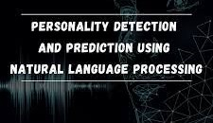
METHODOLOGY: Here when we start our personality prediction we start with a dialogflow asking the questions. Then this dialogflow generates a JSON copy of what the user responds. We view this json in viewable format using online json viewer. After all this through code, we extract the responses through jsonify module. This process is now almost done as the code decides if the user has the trait or not. Lastly the code sends the answers to dialogflow to display it.

Slide 11
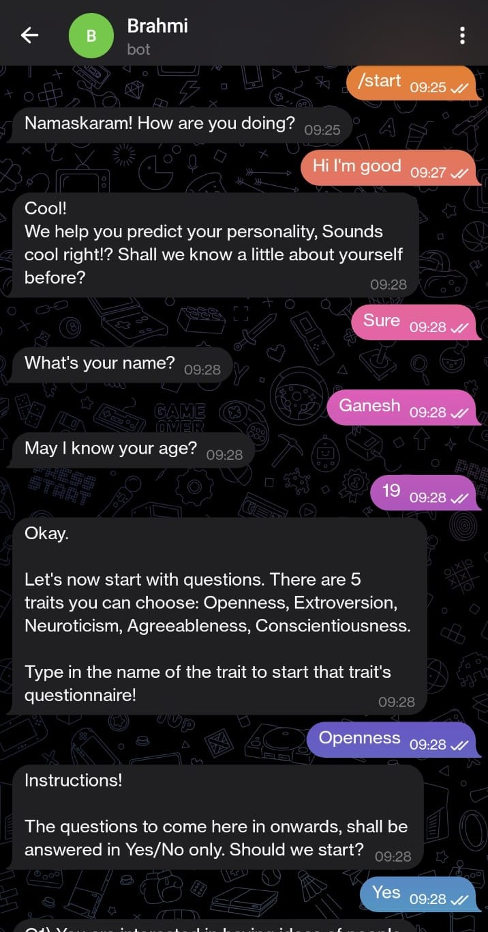
EXPERIMENTAL ANALYSIS: The chatbot is integrated with telegram and tested to obtain expected results.

Slide 12
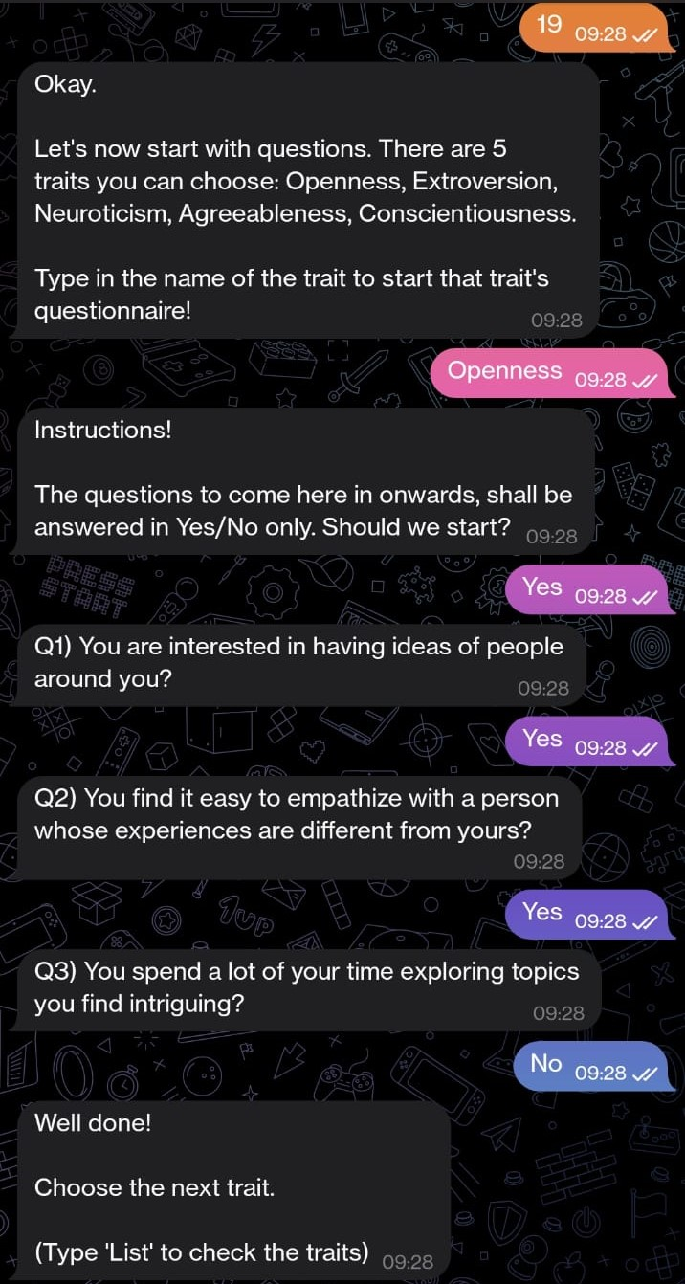
Upon typing start, the chatbot starts responding.First it asks about ourselves and then it allows us to choose from a set of traits which have 3 questions each.

Slide 13
From the chosen trait , you are asked a set of questions to which you are supposed to answer in yes/no format. After you are done answering the questions related to first chosen trait, you have to select another trait. After the completion of the questionaire and based upon your responses, you are given final summary of your personality.

Slide 14
CONCLUSION Recently, there is a sharp increase in the use of machine learning in psychological fields. Personalization is the key to business expanding and offering customer oriented services. Machine learning has a great potential in determining personality traits, which can be further used for self-monitoring. Our model is successful in predicting the personality of an individual based on their answers to our questionnaire. In future this personality prediction model can be employed in many fields like computational advertising, marketing science, job screening to aiding in psychological counselling, intervention and therapy, enhanced human-computer interaction, etc. Therefore, automated personality prediction has important practical applications in diverse areas. REFERENCES: #Udemy for learning ML and NLP #YouTube for learning python #ieeexplore.ieee.org for analysing previous research papers related to personality prediction.

